Slide 1

Chapter 3
Adjusting the Accounts
ACT 201 Lecture
By: Ms. Adina Malik

Slide 2








Timing Issues
Time Period Assumption:
  Also called periodicity assumption
  Accountants divide the economic life of a business into artificial time periods
  Accounting time periods are generally a month, a quarter, or a year.
  Fiscal year vs. calendar year
    Fiscal year: Accounting time period that is one year in length
    Calendar year: January 1 to December 31

Slide 3
Timing Issues
  Accrual vs. Cash Basis Accounting:
Cash Basis Accounting
  Revenues are recognized when cash is received.
  Expenses are recognized when cash is paid.
  Cash-basis accounting is not in accordance with generally accepted accounting principles (GAAP).
  Accrual Basis Accounting
    Transactions recorded in the periods in which the events occur
    Revenues are recognized when earned, rather than when cash is received.
    Expenses are recognized when incurred, rather than when paid.
    In accordance with generally accepted accounting principles (GAAP).

Slide 4
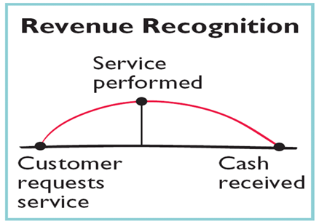
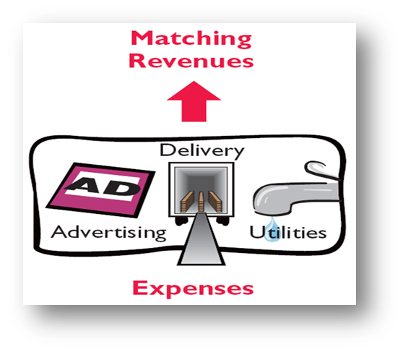
Timing Issues
Recognizing Revenues & Expenses
  Revenue Recognition Principle: Companies recognize revenue in the accounting period in which it is earned. In case of a service enterprise, revenue is considered to be earned at the time the service is performed.
  Matching Principle: Match expenses with revenues in the period when the company makes efforts to generate those revenues. ‘Let the expenses follow the revenues’.

Slide 5
The basics of adjusting entries
Adjusting entries are necessary because the trial balance may not contain up-to-date and complete data.
A company must make adjusting entries every time it prepares financial statements. (conform to GAAP)
Adjusting entries are needed to ensure that the revenue recognition and matching principles are followed.
Adjusting entries make it possible to report correct amounts on the balance sheet and on the income statement.

Slide 6
Types of adjusting entries
Deferrals
Accruals
Prepaid Expense:
Expenses paid in cash & recorded as assets before they are used or consumed.
Unearned Revenue:
Cash received & recorded as liabilities before revenue is earned.
Accrued Revenue:
Revenues earned but not yet received in cash or recorded.
Accrued Expenses:
Expenses incurred but not yet paid in cash or recorded.

Slide 7
Deferrals: Prepaid Expenses
Prepaid expenses are payment of cash, that is recorded as an asset because service or benefit will be received in the future.
Prepayments often occur with regards to insurance, supplies, advertising, rent & maintenance of equipment
Example: On Jan. 1st, Phoenix Consulting paid $12,000 for 12 months of insurance coverage. Show the journal entry to record the payment on Jan. 1st. (Time Period is monthly)
Dr. Cr.
Jan 1 Prepaid Insurance $12,000
Cash $ 12,000

Slide 8
Deferrals: Prepaid Expenses
At each statement date, there are adjustment entries: (1) to record the expenses that apply to the current accounting period (2) to show the unexpired costs in the assets account
Example: On Jan. 1st, Phoenix Consulting paid $12,000 for 12 months of insurance coverage. Show the adjusting journal entry required at Jan. 31st.
Dr. Cr.
Jan 31 Insurance Expenses $1,000
Prepaid Insurance $1,000

Slide 9
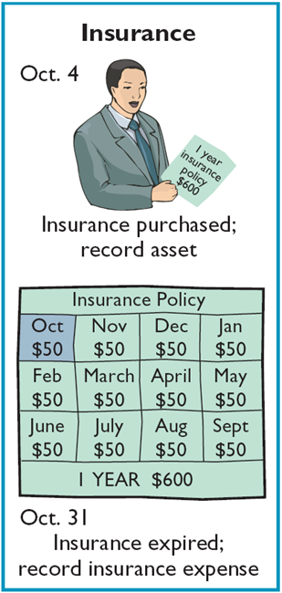
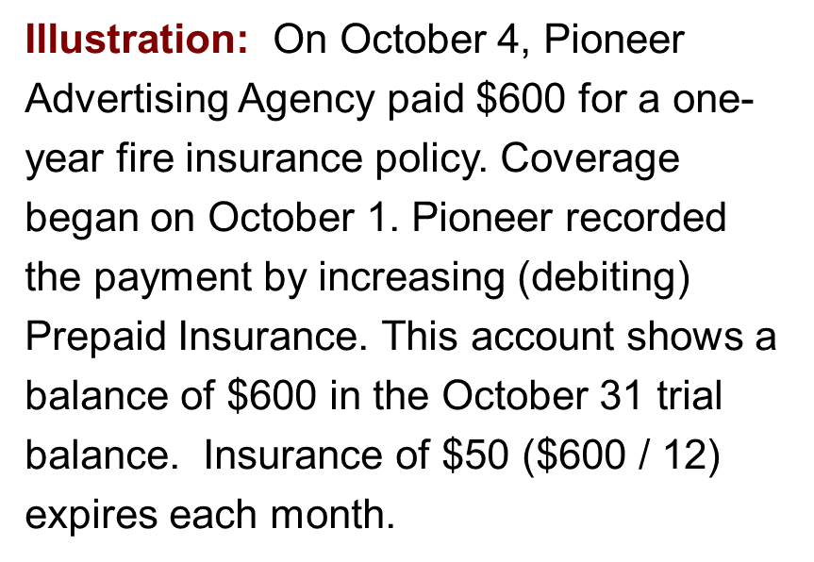
Deferrals: Prepaid Expenses
Adjusting Entry Dr. Cr.
Oct 31 Insurance Expense 50
Prepaid Insurance 50

Slide 10
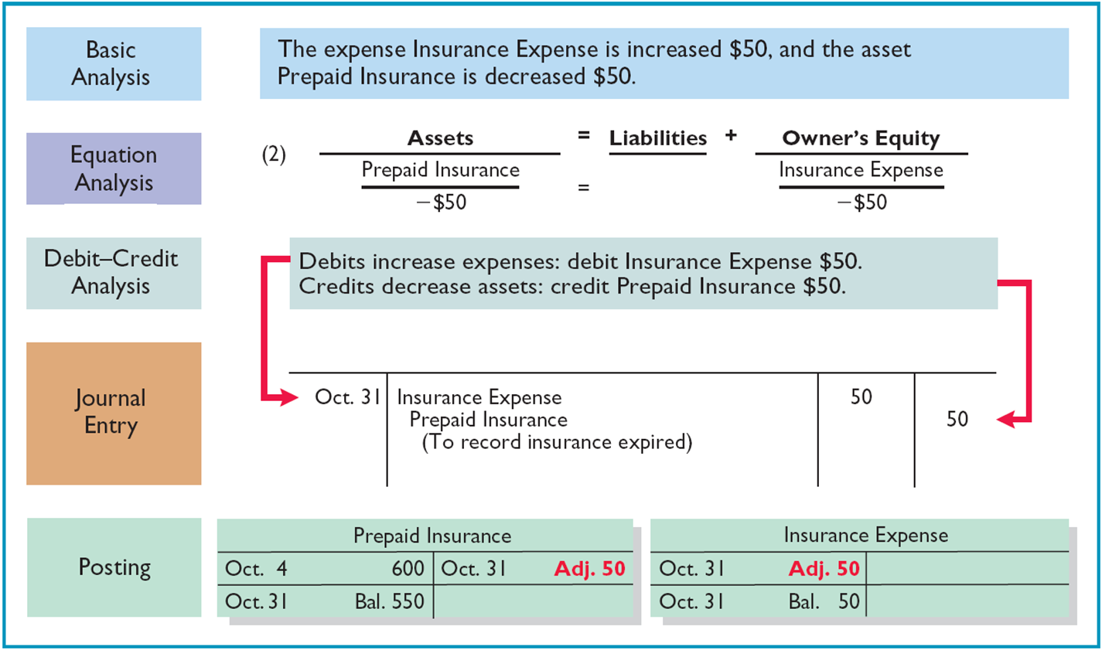
Deferrals: Prepaid Expenses

Slide 11
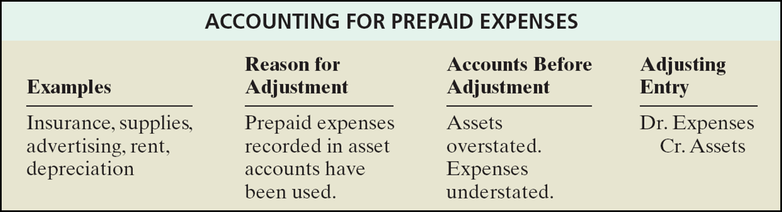
Prepaid Expenses: Summary

Slide 12
Deferrals: Unearned Revenue
Receipt of cash that is recorded as a liability because the revenue has not been earned.
Unearned Revenue often occurs with regards to airline tickets, school tuition, magazine subscriptions, etc.
Example: On Jan. 1st, Phoenix Consulting received $24,000 from Arcadia High School for 3 months rent in advance. Show the journal entry to record the receipt on Jan. 1st in the books of Phoenix Company.
Dr. Cr.
Jan 1 Cash $24,000
Unearned Rent Revenue $24,000

Slide 13
Deferrals: Unearned Revenue
The company makes an adjustment entry to record the revenue that it earns eventually and also to show the liability that remains.
Example: On Jan. 1st, Phoenix Consulting received $24,000 from Arcadia High School for 3 months rent in advance. Show the adjusting journal entry required on Jan. 31st.
Dr. Cr.
Jan 31 Unearned Rent Revenue $ 8,000
Rent Revenue $ 8,000

Slide 14
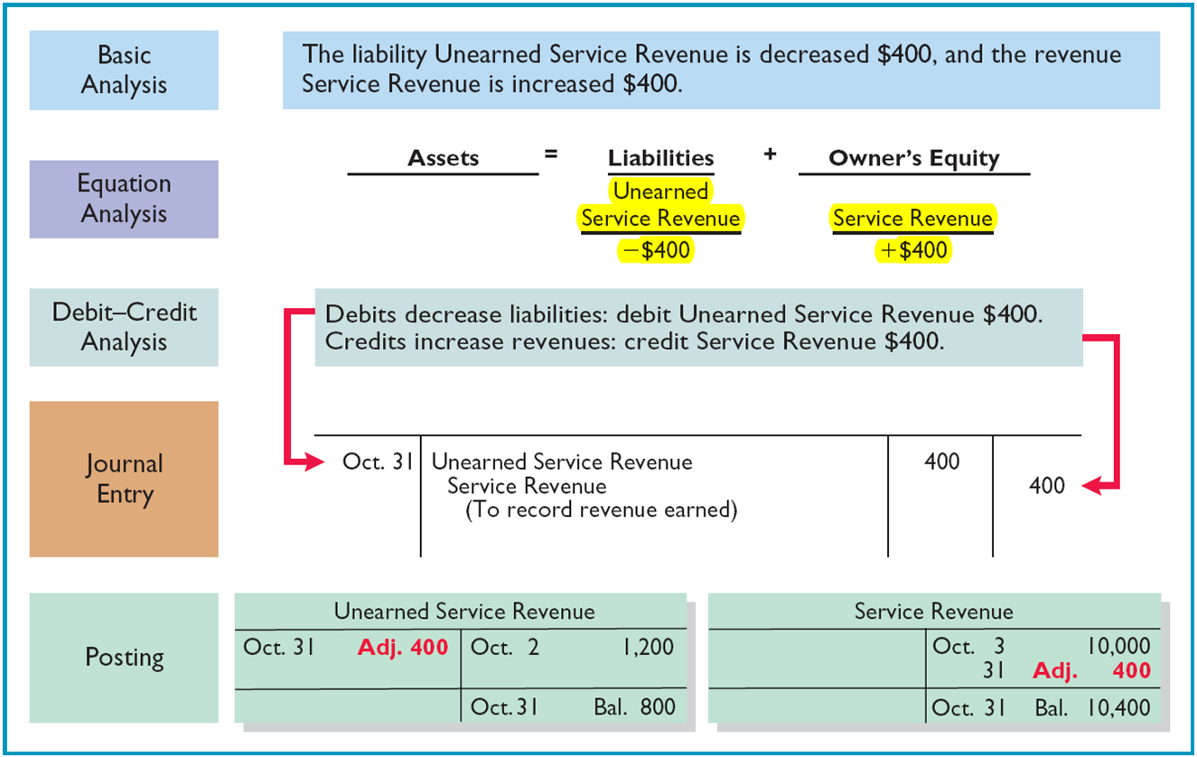
Deferrals: Unearned Revenue
Pioneer Advertising Agency received $1,200 on October 2 from R. Knox for advertising services expected to be completed by December 31. Unearned Service Revenue shows a balance of $1,200 in the October 31 trial balance. Analysis reveals that the company earned $400 of those fees in October.

Slide 15
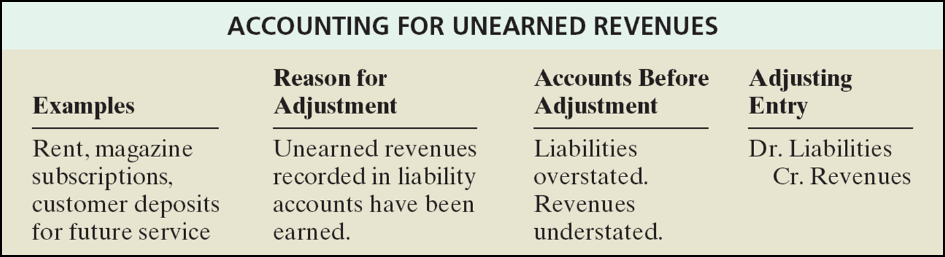
Unearned Revenue: Summary

Slide 16
Accruals: Accrued Revenue
Revenues earned but not yet received in cash or recorded at the statement date
  May accumulate/accrue with the passing of time
  Services performed, but not billed or collected
Example: In Oct 4, Star Advertising Agency earned $ 200 for advertising service that has not been received and recorded.
Show the adjusting journal entry to record the revenue earned on Oct. 31st.
Dr. Cr.
Oct 31 Accounts Receivable $200
Service Revenue $200

Slide 17
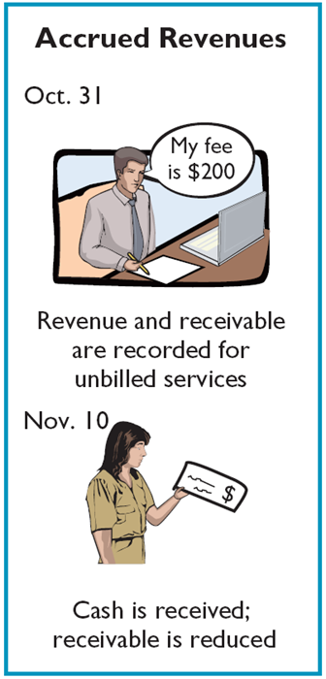
Accruals: Accrued Revenue
In Nov 10, Star Advertising Agency receives $ 200 for the services it performed in October. Show the journal entry to record the transaction.
Dr. Cr.
Nov 10 Cash $200
Accounts Receivable $200
( To record cash collected on account)

Slide 18
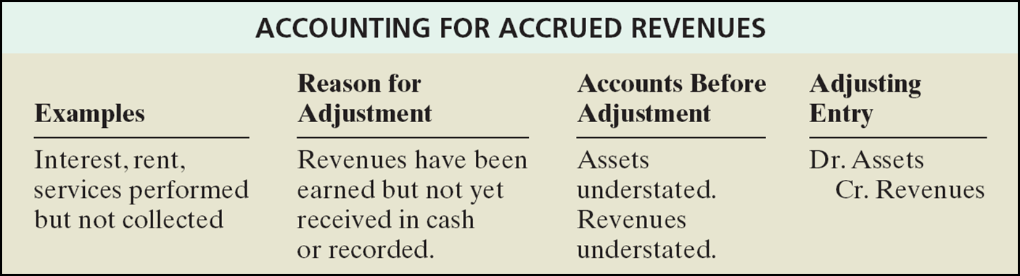
Accrued Revenue: Summary

Slide 19
Accruals: Accrued Expenses
Expenses incurred but not yet paid in cash or recorded at the statement date.
Accrued expenses often incur with regards to rent, taxes, salaries, interest, etc.
Example: On Jan. 2nd, Phoenix Consulting borrowed $200,000 at a rate of 9% per year. Interest is due on first of each month. Show the journal entry to record the borrowing on Jan. 2nd.
Dr. Cr.
Jan 2 Cash $200,000
Notes Payable $200,000

Slide 20
Accruals: Accrued Expenses
An adjusting entry for accrued expenses serves two purposes: (1) It records the existing obligation (2) It recognizes the expenses of the current accounting period.
Example: On Jan. 2nd, Phoenix Consulting borrowed $200,000 at a rate of 9% per year. Interest is due on first of each month. Show the adjusting journal entry required on Jan. 31st.
  Interest Payable : ($200,000 x 9% / 12 months = $1,500)
Dr. Cr.
Jan 31 Interest Expenses $1,500
Interest Payable $1,500
(To record interest on notes payable)

Slide 21
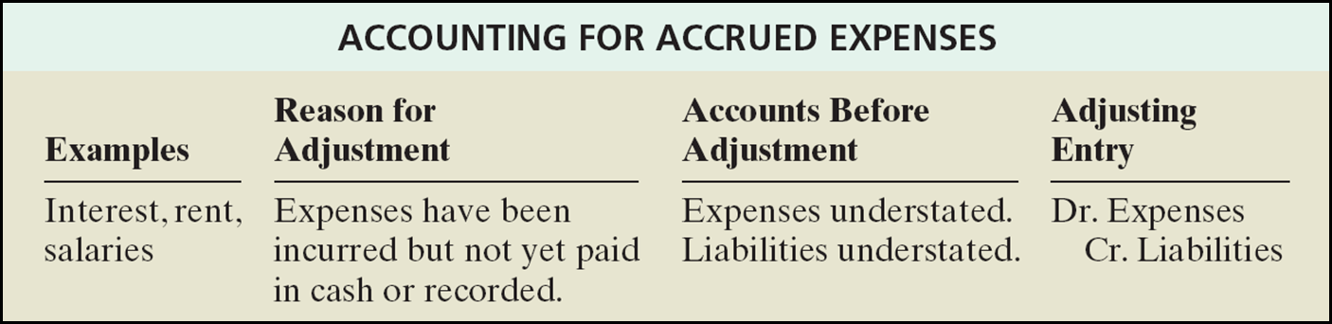
Accrued Expenses: Summary

Slide 22
Adjusted Trial Balance
After all adjusting entries are journalized and posted, the company prepares another trial balance from the ledger accounts (Adjusted Trial Balance).
Its purpose is to prove the equality of debit balances and credit balances in the ledger.
The accounts in the adjusted trial balance contain all data that the company needs to prepare financial statements.

Slide 23
Adjusting The Accounts
Step 1: Preparing General Journal with the Adjusting Entries.
Step 2: Preparing General Ledger with the Adjusting Entries.
Step 3: Preparing Adjusted Trial Balance (to prove equality of debit and credit balances in the ledger & primary basis for preparation of financial statements)
Step 4: Preparing Financial Statements.
Financial Statements
Income Statement
Statement of Retained Earnings
Balance Sheet
Statement of Cash Flows

Slide 24

Question 1
Tony Masasi started his own consulting firm, Masasi Company, on June 1, 2010. The trial balance at June 30 is shown below.
In addition to the accounts listed on the trial balance, the chart of accounts for Masasi Company also contains the following accounts and account numbers:
No. 212 Salaries Payable, No. 244 Utilities Payable, No. 631 Supplies Expense, No. 722 Insurance Expense and No. 732 Utilities Expense

Slide 25
Question 1 (continued)
Other data:
Supplies on hand at June 30 are $600.
A utility bill of $150 has not been recorded and will not be paid until next month.
The insurance policy is for a year.
$2,500 of unearned service revenue has been earned at the end of the month.
Salaries of $2,000 are accrued at June 30.
Invoices representing $1,000 of services performed during the month have not been recorded as of June 30.
Prepare the adjusting entries for the month of June. Use J3 as the page number for your journal.
Post the adjusting entries to the ledger accounts. Enter the totals from the trial balance as beginning account balances.
Prepare an adjusted trial balance at June 30, 2010.

Slide 26

Question 2
Terry Thomas opens the Green Thumb Lawn Care Company on April 1. At April 30, the trial balance shows the following balances for selected accounts.
Prepaid Insurance $ 3,600
Notes Payable $ 20,000
Unearned Revenue $ 4,200
Service Revenue $ 1,800
Analysis reveals the following additional data.
Prepaid insurance is the cost of a 2 year insurance policy, effective from April 1.
The note payable is dated April 1. It is a 12% note per year.
Seven customers paid for the company’s 6 months’ lawn service package of $600 each beginning in April. The company performed services for these customers in April.
Lawn services provided to other customers but not recorded at April 30 totaled $ 1,500.
Prepare the adjusting entries for the month of April. Show computations.

